Slide 1
Simeon Stylites
Photographs and text are from Wikipedia.org, article on “Simeon Stylites” except final slide photograph and text are from article on “Katskhi pillar.”
Accessed July 19, 2020.
Content in brackets on the final slide is added by Ken Hart.

Slide 2
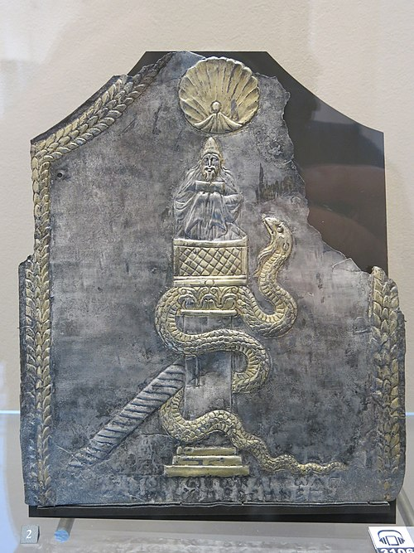
6th-century depiction of Simeon on his column. A scallop shell symbolizing spiritual purity blesses Simeon; the serpent represents demonic temptations (Louvre).

Slide 4
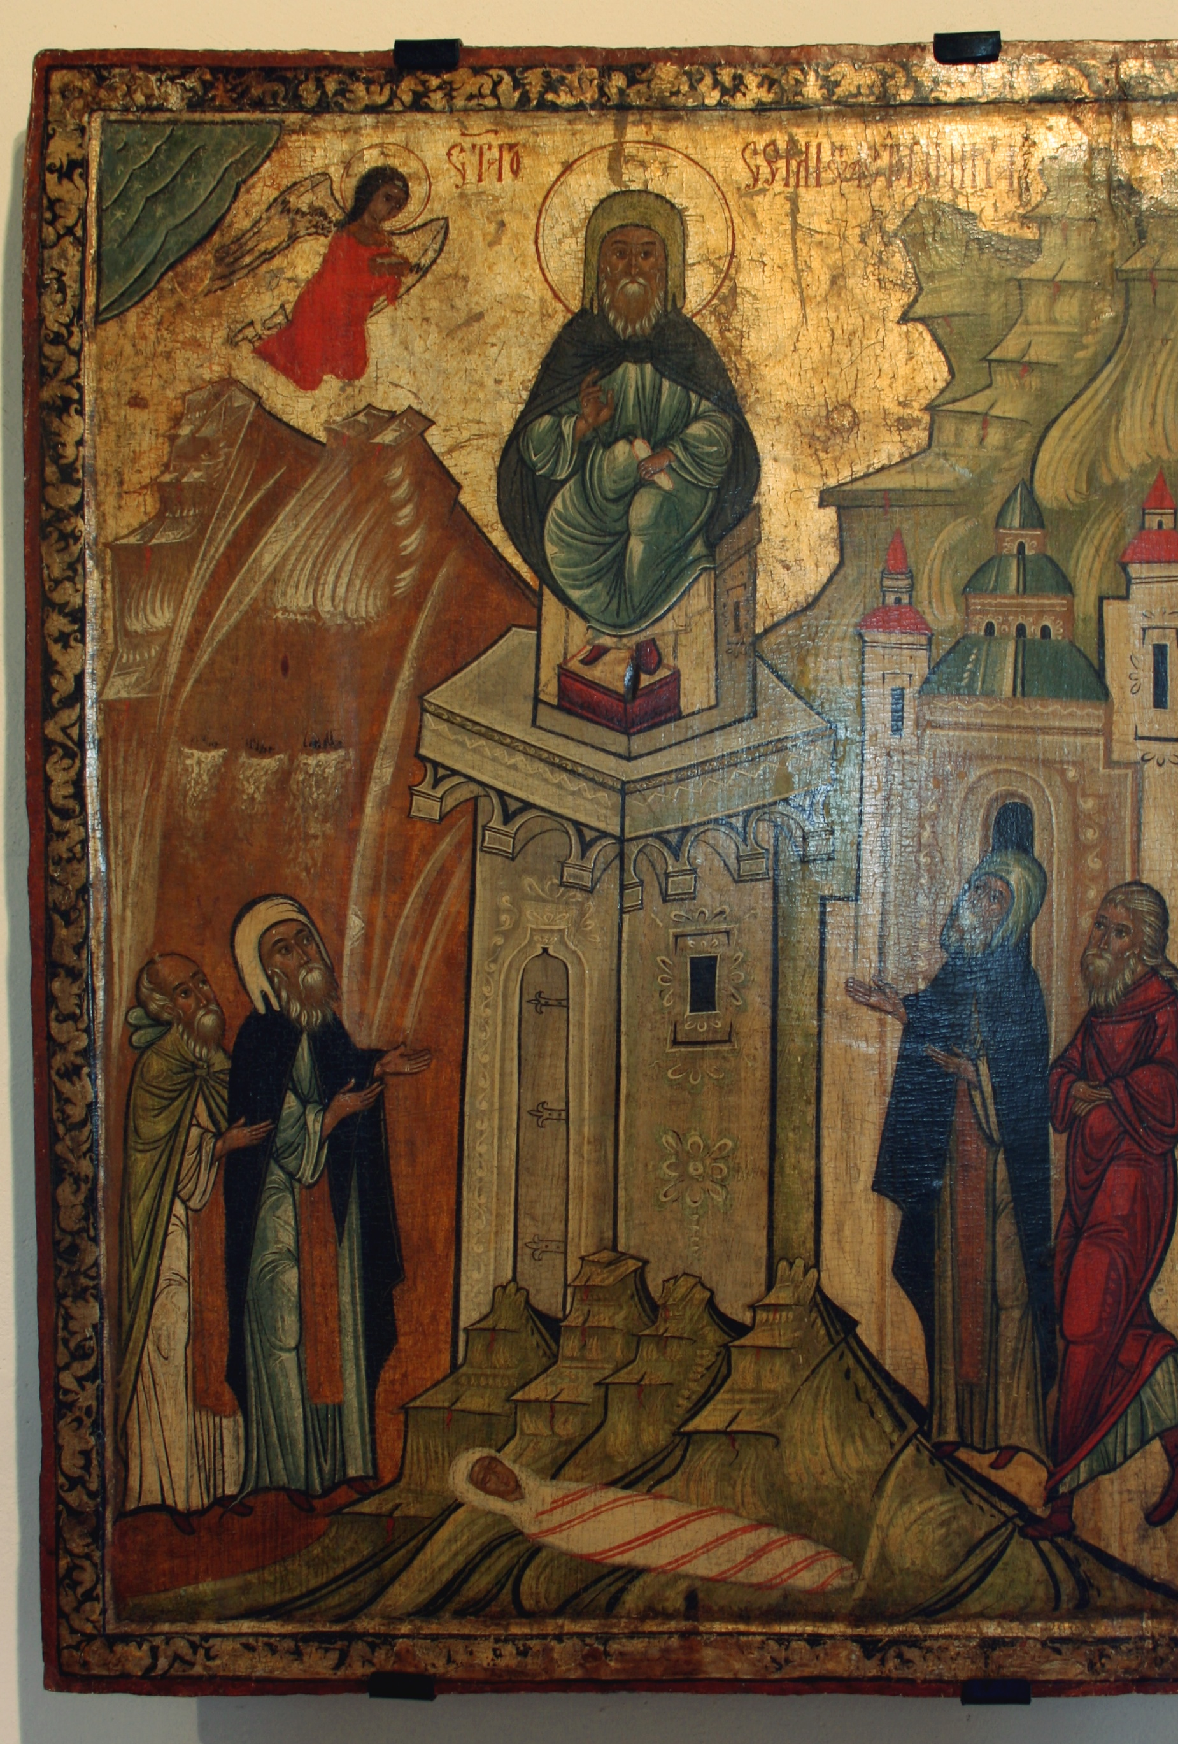
16th-century icon of Simeon Stylites. At the base of the pillar is his mother's body.

Slide 5
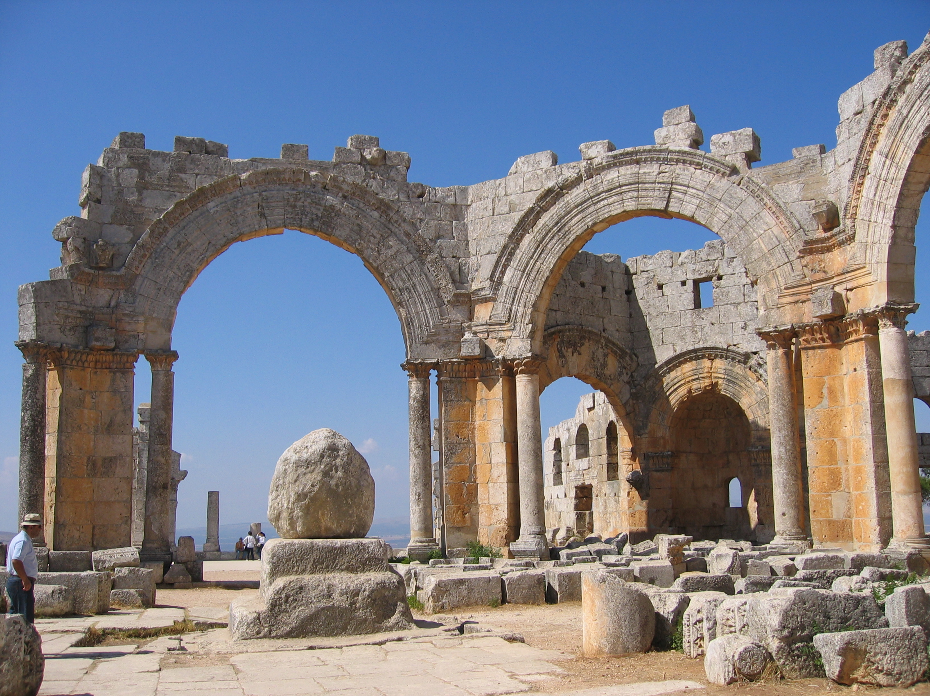
Ruins of the Church of Saint Simeon with remains of his column (centre, now topped with a boulder)

Slide 6
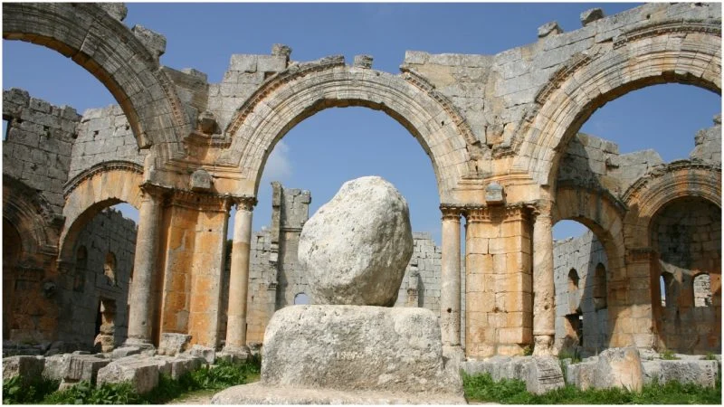

Slide 7
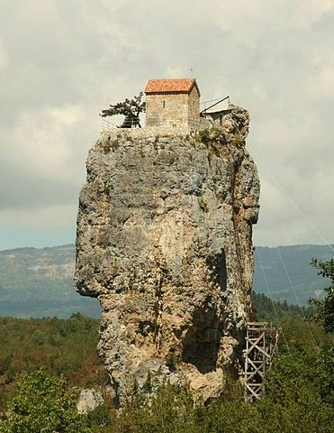
[People are still trying to get closer to God this way.] The Katskhi pillar (Georgian: კაცხის სვეტი, kac'xis svet'i) is a natural limestone monolith located at the village of Katskhi in western Georgian region of Imereti, near the town of Chiatura. It is approximately 40 metres (130 ft) high, and overlooks the small river valley of Katskhura.
[Content in brackets is added by Ken Hart.]

